Slide 1
MSc DISSERTATION
Short and Long Term Predictions of Emergency
Department Patient Resources in the
Irish Health Sector

Slide 2
MOTIVATION
1 / 14
Why forecast trolley numbers?
15+ yrs
▪ Overcrowding on ED trolleys is linked to longer hospital stays, worse clinical outcomes and heavy staff burden.
▪ Trolley waits are one of the most closely watched indicators of Irish health system performance.
▪ Machine learning has grown rapidly for hospital demand forecasting internationally, but rarely targets the trolley count itself most studies forecast attendance or admissions instead.
▪ Microsoft Azure AutoML automatically trains, cross-validates and ranks a wide range of forecasting algorithms, lowering the technical barrier to building a forecasting tool.
▪ This thesis applies Azure AutoML directly to HSE's own published trolley data to test how accurately, and at what level of temporal detail, ED trolley numbers can be forecast.
HSE has published daily Trolley Watch figures since 2006; despite policy interventions numbers have kept rising
882 / 128 / 29
daily, weekly and monthly records used for the three AutoML forecasting experiments

Slide 3
RESEARCH QUESTIONS
2 / 14
Three questions
Can Azure Automated Machine Learning forecast HSE ED trolley numbers accurately, and does the temporal granularity of the data daily, weekly or monthly change what can be trusted?
1
Accuracy (RQ1)
2
Granularity (RQ2)
3
Practical limits (RQ3)
How accurately can AutoML forecast ED trolleys, benchmarked against Jilani et al. (2019)'s UK ED-attendance study using MAE, RMSE, MAPE and R²?
Does training at daily, weekly or monthly aggregation change forecast accuracy and reliability?
What limitations affect using an AutoML-selected ensemble for real hospital capacity planning?

Slide 4
LITERATURE REVIEW
3 / 14
The gap in the literature
▪ The Irish trolley crisis is well documented (Lynch et al., 2019; IMO, 2018; HIQA, n.d.) but rarely modelled with formal forecasting methods.
▪ The base study, Jilani et al. (2019), forecast ED attendance across four UK hospitals with a fuzzy time series model, benchmarked against ARIMA and neural networks.
▪ Modern literature has shifted toward gradient-boosted and ensemble methods (XGBoost, LightGBM) which generally outperform classical statistical models such as ARIMA.
▪ Almost every reviewed study forecasts attendance or admissions not the trolley count that drives daily Irish hospital operations.
▪ No comparable Irish study tests daily vs weekly vs monthly granularity side by side.
This thesis extends the weekday-segmented, multi-model comparative framework of Jilani et al. (2019) to a metric not directly investigated before: HSE trolley waiting numbers in Ireland compared for the first time across daily, weekly and monthly granularity.

Slide 5
METHODOLOGY
4 / 14
The approach
1
Quantitative, predictive design
2
Three granularities
Secondary time-series data; ED Trolleys forecast as a continuous regression target, not a classification problem.
Independent Azure AutoML experiments at daily, weekly and monthly level same target, same configuration, different aggregation.
3
Time-aware validation
4
Four accuracy metrics
Rolling-origin cross-validation; the model is always tested on a period that follows its training data, so no future information leaks in.
MAE, RMSE, MAPE and R², matching the metrics used in the closest published benchmark, Jilani et al. (2019).
All three experiments (daily, weekly, monthly) used Normalized RMSE as the primary metric with 100% sampling; VotingEnsemble was the best algorithm in every case (job durations 37m to 2h 06m).

Slide 6
DATA
5 / 14
Data and variables
HSE Urgent and Emergency Care Report (“TrolleyGAR”)
All three experiments use the same predictor set, the same target and the same Azure AutoML configuration. Only the temporal aggregation of the underlying data changes - so differences in accuracy across the three granularities can be attributed to the aggregation itself.
▪ Secondary data only no patient-level records.
▪ 1 January 2024 to 31 May 2026: 882 daily records, aggregated to 128 weekly and 29 monthly records.
▪ Target (Y): ED Trolleys a continuous count, modelled as regression.
Predictors (X)
▪ Ward Trolleys, Surge Capacity in Use, Delayed Transfers of Care
▪ Patients waiting over 24 hours (total, and aged 75+)
▪ Calendar features: Year, Month, Week number, Day of week
▪ Total (ED + Ward) deliberately excluded including it would leak the target.

Slide 7
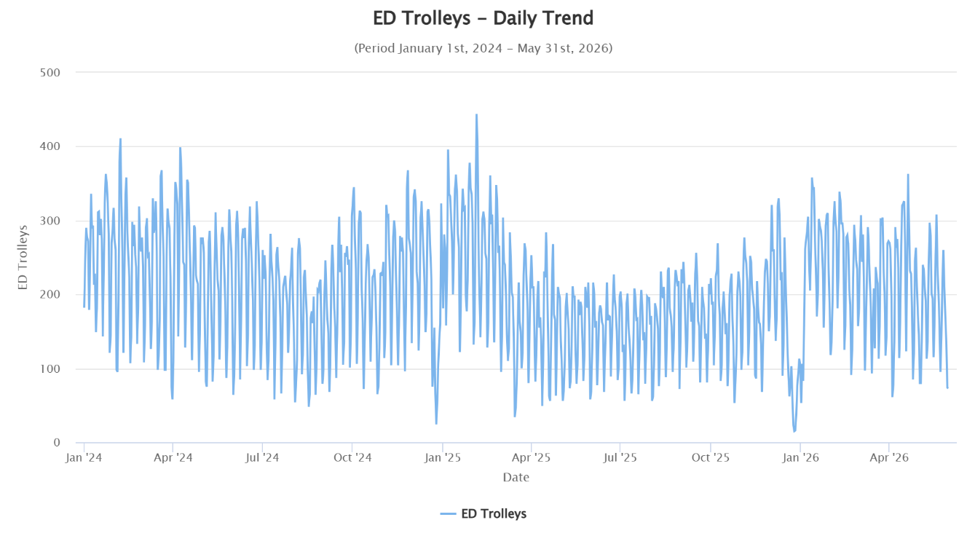
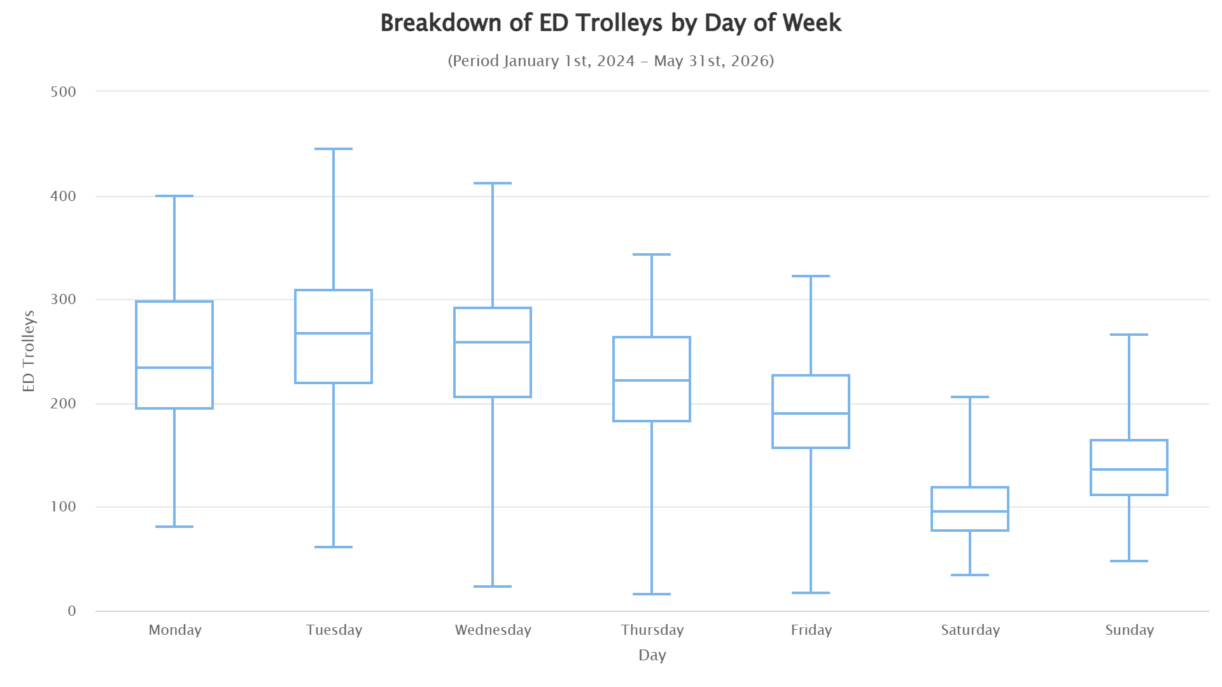
EXPLORATORY ANALYSIS
6 / 14
Daily trend and seasonality
▪ Trolleys fluctuate within roughly 50–300 across most of the period.
▪ Sharp winter peaks, most visible around January 2025, briefly exceeding 440.
▪ Pattern consistent with known seasonal winter pressure on Irish EDs.
▪ It is these spikes not the calmer summer months that a forecasting model most needs to anticipate.
Figure 3: ED Trolleys, daily trend, Jan 2024 – May 2026
Numbers are consistently highest on Tuesday/Wednesday and lowest at weekends; Surge Capacity in Use rises near-linearly with Total Trolleys, confirming it as a genuine predictor.
The distribution is right-skewed with a thin tail of very busy days up to 450; monthly averages peak in January (about 258) and trough in August (about 160), a roughly 100-trolley seasonal swing.

Slide 8
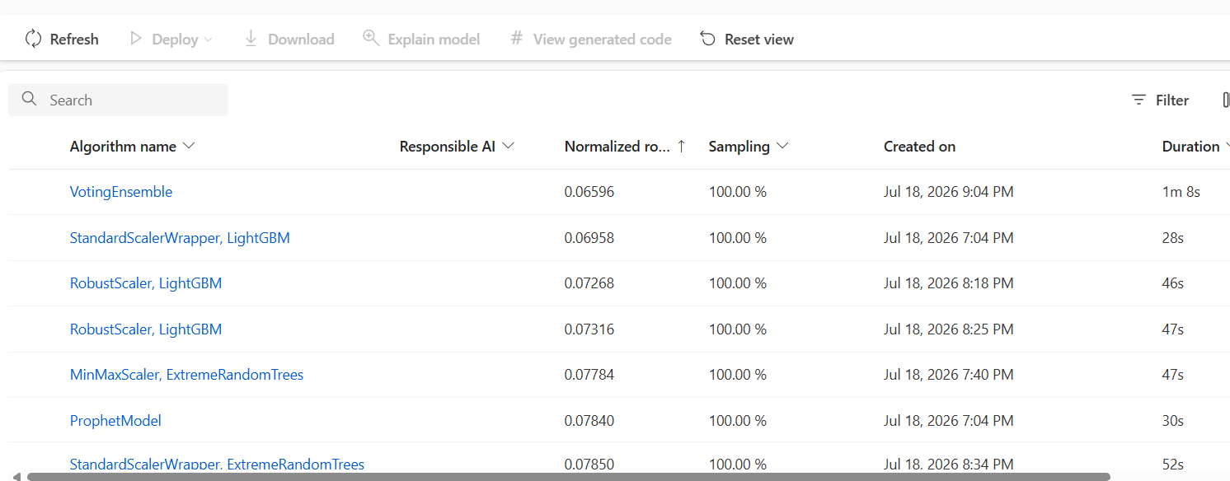
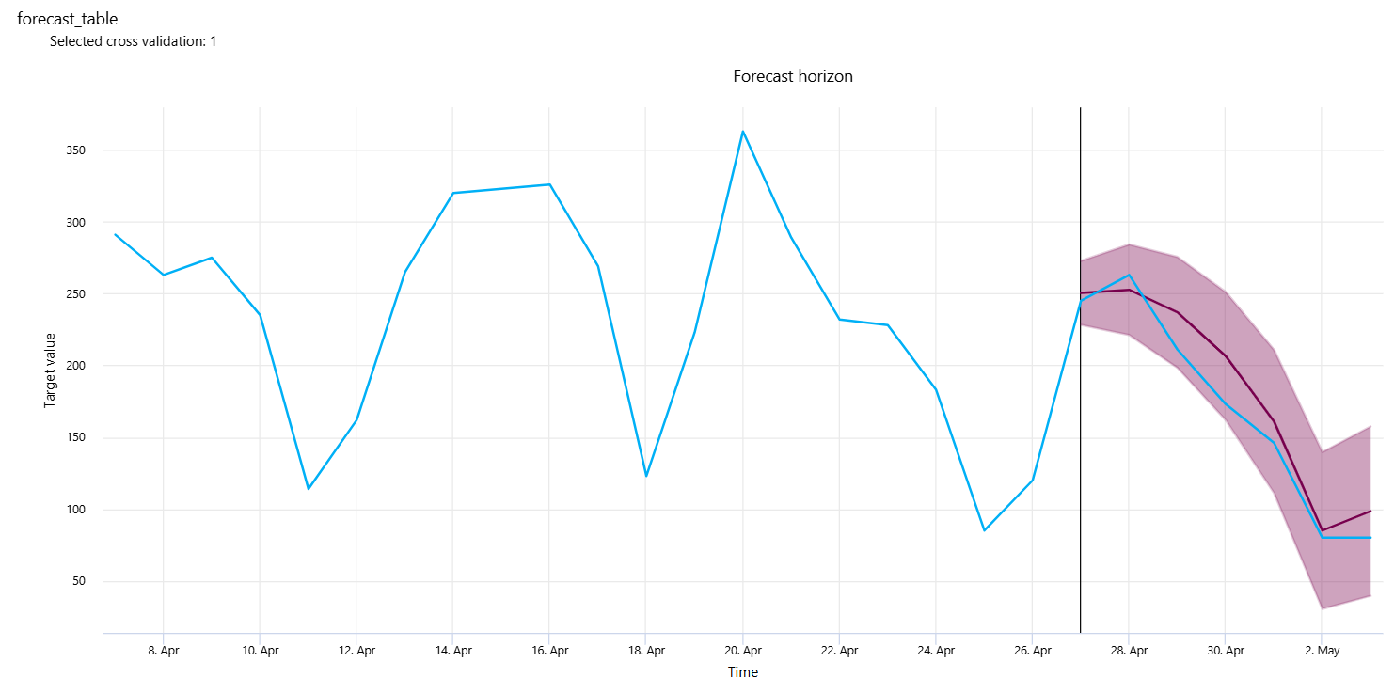
RESULTS · DAILY
7 / 14
Daily forecasting experiment (RQ1)
Figure 9: Daily leaderboard, ranked by normalized RMSE
Metric | Value
MAE / RMSE | 23.63 / 28.30
MAPE | 15.08%
R² | 0.758
Figure 10: Daily forecast vs actual, selected validation fold
▪ VotingEnsemble beat ProphetModel (univariate) by ~19% normalized RMSE - the HSE pressure predictors add real value.
▪ MAPE (15.08%) sits well above the Jilani et al. daily benchmark of 2.63–4.72%.
▪ Residuals mostly within ±40 trolleys, with larger misses of –80 to –120 around demand spikes (Figure 11).

Slide 9
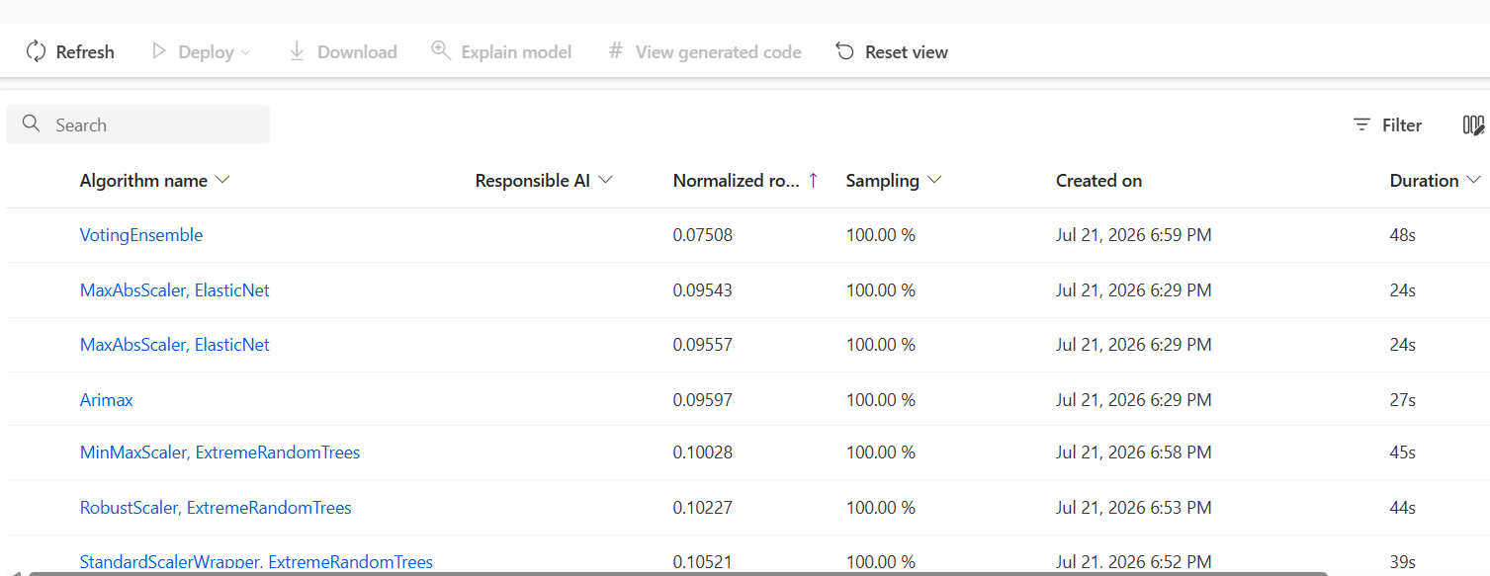
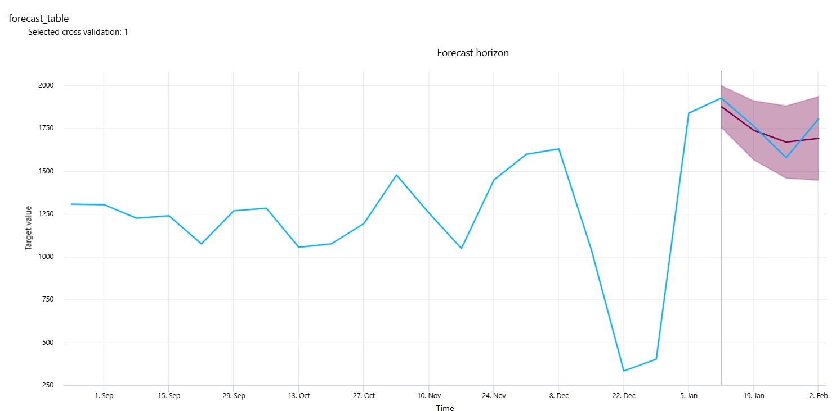
RESULTS · WEEKLY
8 / 14
Weekly forecasting experiment
Figure 12: Weekly leaderboard, ranked by normalized RMSE
Metric | Value
MAE / RMSE | 110.47 / 133.41
MAPE | 7.37%
R² | 0.207
Figure 13: Weekly forecast vs actual, selected validation fold
▪ VotingEnsemble beat the next-best model (MaxAbsScaler-ElasticNet) by ~27%; a classical Arimax baseline performed only marginally better than that.
▪ Aggregating to 128 weekly records cut MAPE substantially versus daily, at the cost of a much lower R².
▪ Forecast tracks the general trend but misses the depth of the late-December trough.

Slide 10
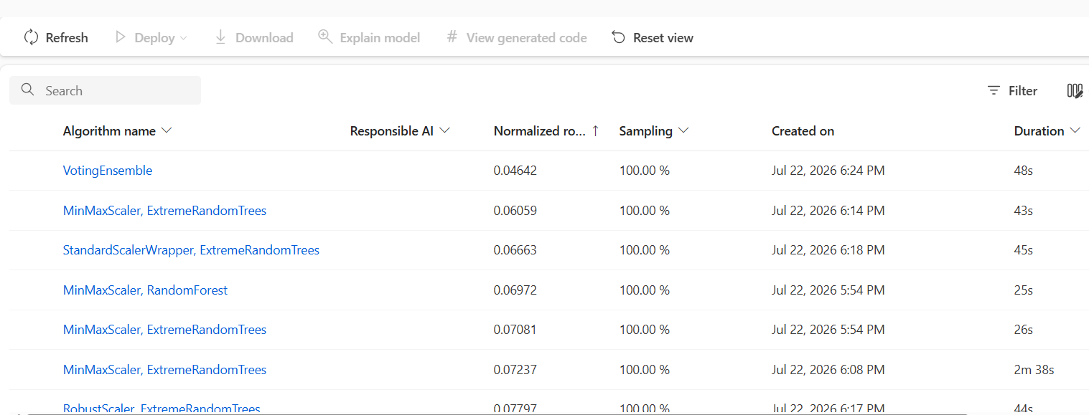
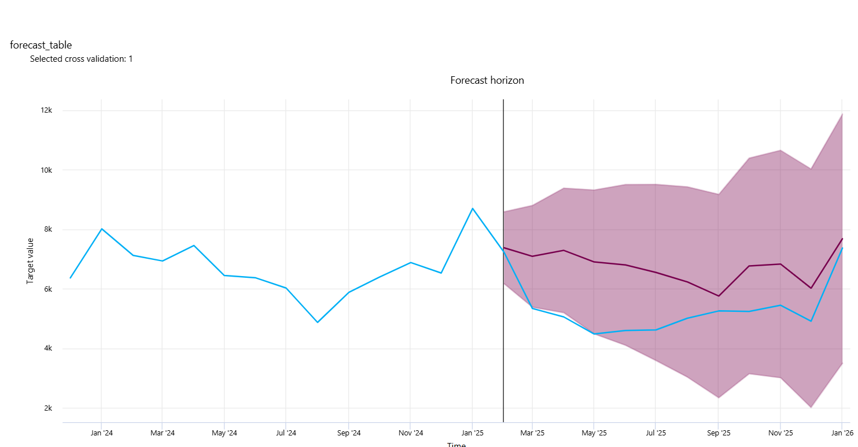
RESULTS · MONTHLY
9 / 14
Monthly forecasting experiment
Figure 15: Monthly leaderboard, ranked by normalized RMSE
Metric | Value
MAE / RMSE | 175.48 / 195.81
MAPE | 3.44%
R² | 0.139
Figure 16: Monthly forecast vs actual, selected validation fold
▪ Lowest MAPE of the three experiments (close to Jilani et al.'s long-term benchmark) but the lowest R², trained on only 29 records.
▪ A date-parsing error (day-month-year read as month-day-year) distorted the forecast_table chart axis - flagged as provisional pending a corrected re-run.
▪ Wider, less symmetric residuals than daily or weekly, reflecting the small training set.

Slide 11
COMPARISON
10 / 14
The granularity trade-off (RQ2)
Granularity | Records | Best algorithm | MAE | RMSE | MAPE (%) | R²
Daily | 882 | Voting Ensemble | 23.63 | 28.30 | 15.08 | 0.758
Weekly | 128 | Voting Ensemble | 110.47 | 133.41 | 7.37 | 0.207
Monthly | 29 | Voting Ensemble | 175.48 | 195.81 | 3.44 | 0.139
MAPE falls monotonically from daily to monthly; R² falls in the same direction. This is a sample-size effect (882 → 29 records) rather than evidence that coarser forecasts are simply ‘better’.
▪ Daily: most statistically valid (highest R²), but the highest relative error.
▪ Monthly: smallest percentage error, but trained on just 29 records - accuracy is less robust than the headline MAPE suggests.
▪ Weekly: the most defensible balance of sample size, stability and accuracy - the most practically usable of the three.

Slide 12
DISCUSSION
11 / 14
Interrogating the AutoML-selected model
▪ The leaderboard at every granularity includes credible alternatives - Arimax, Prophet, regularised linear models, tree ensembles - so the Voting Ensemble's edge is a measured outcome, not an assumption.
▪ Azure exports only one of five rolling-origin validation folds per experiment ('Selected cross validation: 1'), so how much accuracy varies fold-to-fold, and whether it drops around Christmas/New Year, remains an open question.
▪ A supplementary, independently run 5-fold cross-validation (daily, gradient-boosted) shows a 3x swing in MAPE between the best fold (12.56%) and the worst (56.94%, over Christmas/New Year) - illustrating exactly the fold-level variability Azure's single exported fold hides.
Fold | Test period | MAE | MAPE (%)
1 | 5 Aug – 3 Oct 2025 | 19.46 | 11.76
2 (best) | 4 Oct – 2 Dec 2025 | 19.33 | 12.56
3 (worst) | 3 Dec 2025 – 31 Jan 2026 | 40.43 | 56.94
4 | 1 Feb – 1 Apr 2026 | 29.41 | 15.30
5 | 2 Apr – 31 May 2026 | 22.49 | 12.31
Table 4: Supplementary rolling-origin cross-validation, daily granularity

Slide 13
LIMITATIONS
12 / 14
Boundaries and next steps
Limitations
Recommended future work
▪ Findings are specific to HSE data on Azure AutoML - not generalisable to other health systems or AutoML platforms without further testing.
▪ Monthly experiment trained on only 29 records; a true data constraint, not a design choice.
▪ Model-level feature importance was not retained by Azure; predictor evidence relies on correlation, which is weaker than model-derived importance.
▪ Fold-level consistency of the winning model could not be evaluated - only one of five validation folds is exported per experiment.
▪ Extract or reproduce per-fold accuracy for the Azure-selected model to test holiday-period reliability directly.
▪ Extend the weekly and monthly datasets as more HSE history becomes available, to stabilise the monthly R².
▪ Add exogenous predictors - public holiday flags, seasonal flu indicators, staffing levels.
▪ Repeat the daily/weekly/monthly comparison at individual hospital or hospital-group level.

Slide 14
CONCLUSIONS
13 / 14
What the study establishes
1
Directionally useful, not benchmark-beating
2
Granularity is a trade-off, not a hierarchy
Azure AutoML forecasts ED trolleys usefully, but no granularity reached Jilani et al.'s short-term MAPE benchmark of 2.63–4.72%.
MAPE improves and R² worsens together from daily to monthly - a sample-size effect, not proof that coarser is better.
3
Weekly is the most defensible choice
4
An AutoML model is a starting point
The best balance of accuracy, stability and sample size for real hospital capacity planning.
Leaderboard alternatives, fold-level consistency and platform quirks all need interrogation - not just the headline metric.
Practically, forecast weekly by default, widen error margins around holidays, and use trolley forecasts alongside other pressure indicators rather than as a stand-alone predictor.

Slide 15
THANK YOU

